Slide 1

Mohs10 Selenium Hybrid Framework

Slide 2
Agenda
Brief Introduction about Selenium
What is a TEST Automation Framework?
What is Hybrid Testing and why?
Framework Design
Framework Components
Key Enhancements in Framework
Steps to Create framework from Scratch

Slide 3
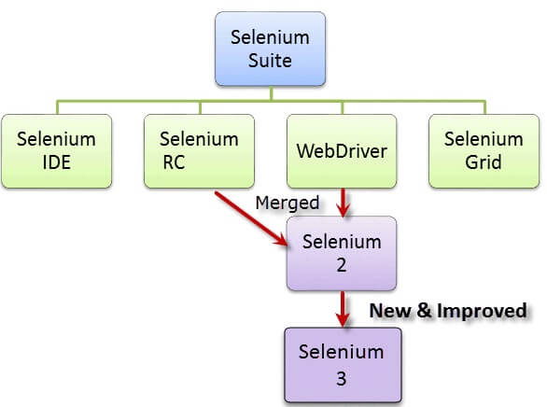
Selenium and It’s History
Selenium is a free (open source) automated testing suite for web applications across different browsers and platforms. Selenium is not just a single tool but a suite of software's, each catering to different testing needs of an organization. It has four components.
Selenium Integrated Development Environment (IDE)
Selenium Remote Control (RC)
WebDriver
Selenium Grid

Slide 4
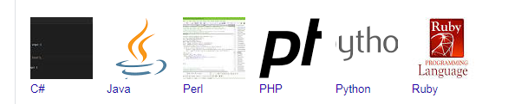
Selenium Supporting Environment
Operating Environment - MS Windows, Linux, Apple OX
Programming Languages:
Application Environment – Web Based and Mobile Based web applications which has web forms.

Slide 5
What is a TEST Automation Framework?
A set of guidelines like coding standards , test-data handling , object repository treatment etc...
which when followed during automation scripting produce beneficial outcomes like increase code re-usage , higher portability , reduced script maintenance cost etc.
Mind you these are just guidelines and not rules; they are not mandatory and you can still script without following the guidelines. But you will miss out on the advantages of having a Framework.

Slide 6
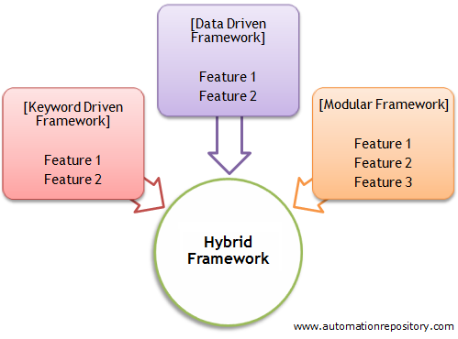
What is Hybrid Testing?
The Hybrid framework offers advantage by functioning as a combination of both Keyword and Data-Driven framework as it is a mix of both the Data-Driven and Keyword Driven frameworks.

Slide 7
Advantages
The Hybrid-Driven Testing pattern is made up of a # of reusable modules / function libraries are developed with the following characteristics in mind:
Maintainability – significantly reduces the test maintenance effort
Reusability – due to modularity of test cases and library functions
Manageability – effective test design, execution, and traceability
Accessibility – to design, develop & modify tests whilst executing
Availability – scheduled execution can run unattended on a 24/7 basis
Reliability – due to advanced error handling and scenario recovery
Flexibility – framework independent of system or environment under test
Measurability – customizable reporting of test results ensure quality.

Slide 8
Why Hybrid Testing?
Eg: We want to test the login system with multiple input fields with 100 different data sets.
To test this, you can take following different approaches:
Approach 1) Create 100 scripts one for each dataset and runs each test separately one by one.
Approach 2) Manually change the value in the test script and run it several times.
Approach 3) In this case, the keywords as well as the test data are externalized. Keywords are stored in a separate Java class file and test data can be maintained in a Properties file or an Excel file.
In the given three scenarios first two are laborious and time-consuming. Therefore, it is ideal to follow the third approach.
Thus, the third approach is nothing but a Hybrid - Driven framework.

Slide 9
Framework Design
Selenium Webdriver is being used as the core automation engine.
Eclipse IDE is used to develop the automated scripts.
Build tool Maven is used for build, execution and dependency purpose.
Hybrid framework is used for organizing the scripts
Test data is read from Excel sheet at run time.
Git and Github is used for version control management.
CI tool Jenkins is used to run the scripts.
Extent Reports test results are generated for each run.
Project/Application: Demo Web Shop
No. of Test Cases: 10 Test Cases
Automation Tools : Selenium Web Driver, Hybrid framework and Java

Slide 10
Main Package
Test Package
Base Class
Action Class
Common Utilities
Test Data / Config
Logs & Report
Browser, Plug-in & Language
Create TestNGsuite.xml
Update Dependencies(POM.xml)
Git Repositories( Push)
Continues Integration(Jenkins)

Slide 11
Key Components in this Framework
Hybrid with reusable components and classes
Cross Browser Testing
New Selenium Customized functions
Maven for Jar files version control
Created dependencies for Jar files using Maven
Git configuration
Jenkins Integration
Ready to use Frame work

Slide 12
Selenium Framework Integration
Maven:
Using Maven for build, execution and dependency purpose. Integrating the TestNG dependency in POM.xml file and running this POM.xml file using Jenkins.
Version Control Tool:
We use Git as a repository to store our test scripts.
Jenkins:
By using Jenkins CI (Continuous Integration) Tool, we execute test cases on daily basis and also for nightly execution based on the schedule. Test Result will be sent to the peers using Jenkins.

Slide 13
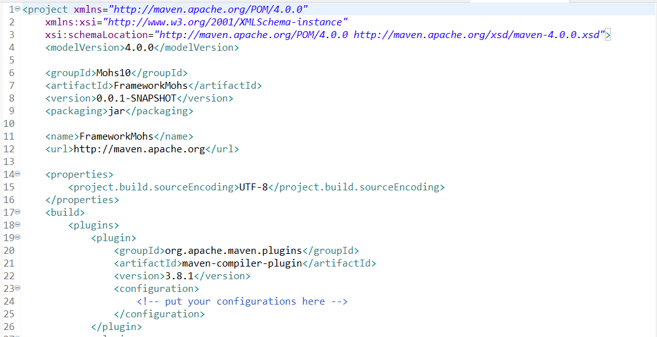
Selenium Framework Integration with CI Tool
MAVEN Configuration

Slide 14
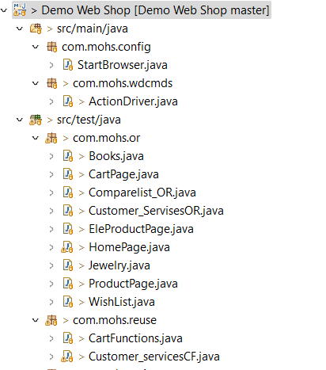
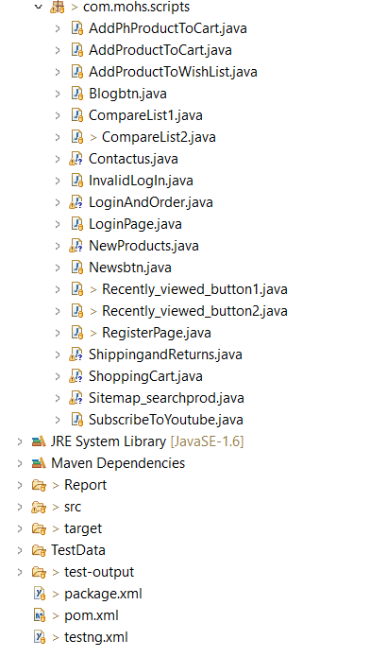
Project Structure
Page Object Model is a design pattern to create Object Repository for web UI elements.

Slide 15
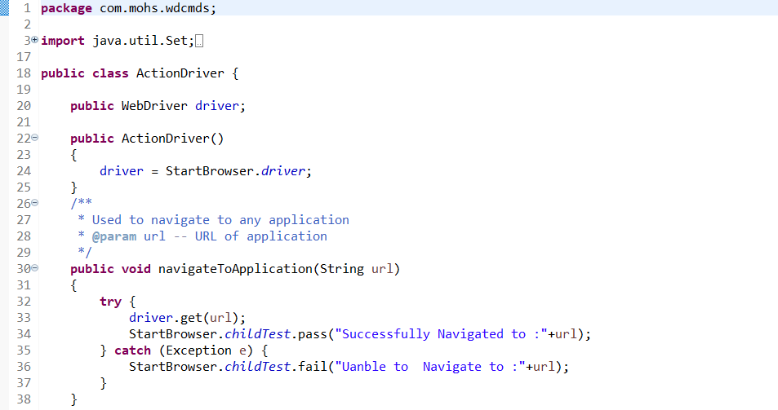
Action Driver Package
ActionDriver class contains all generic functions/ customized functions like clicking on an element, verifying element or text, Waitforelementpresent, mousehover and rightclick etc.

Slide 16
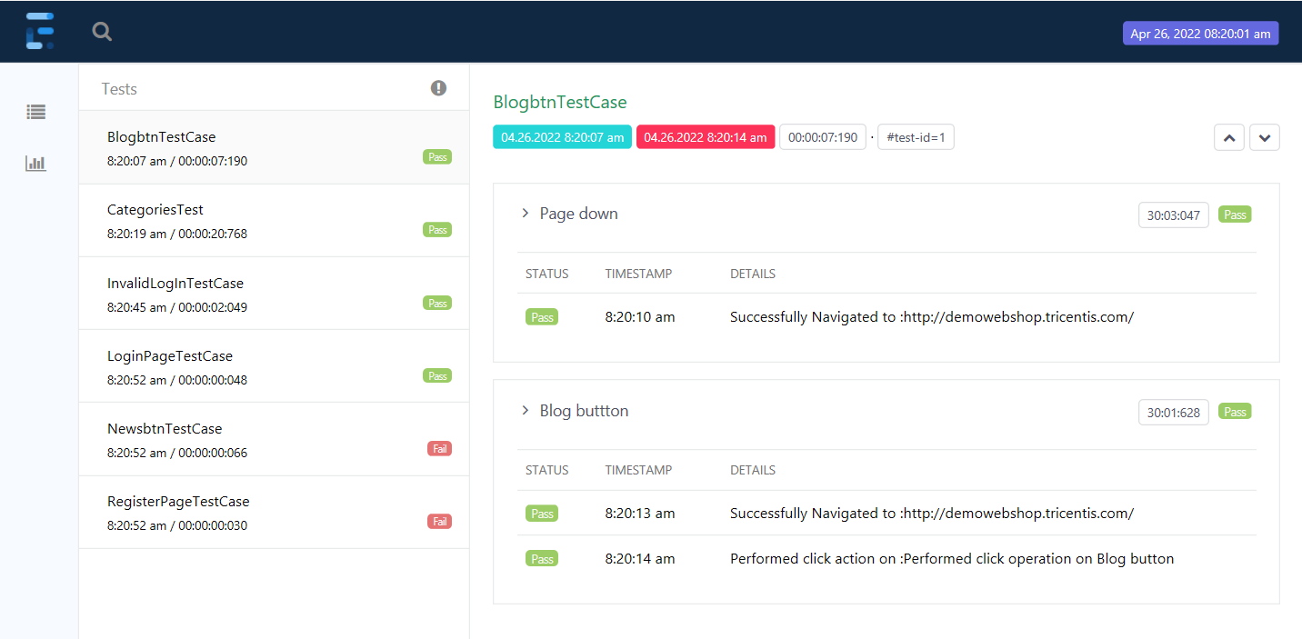
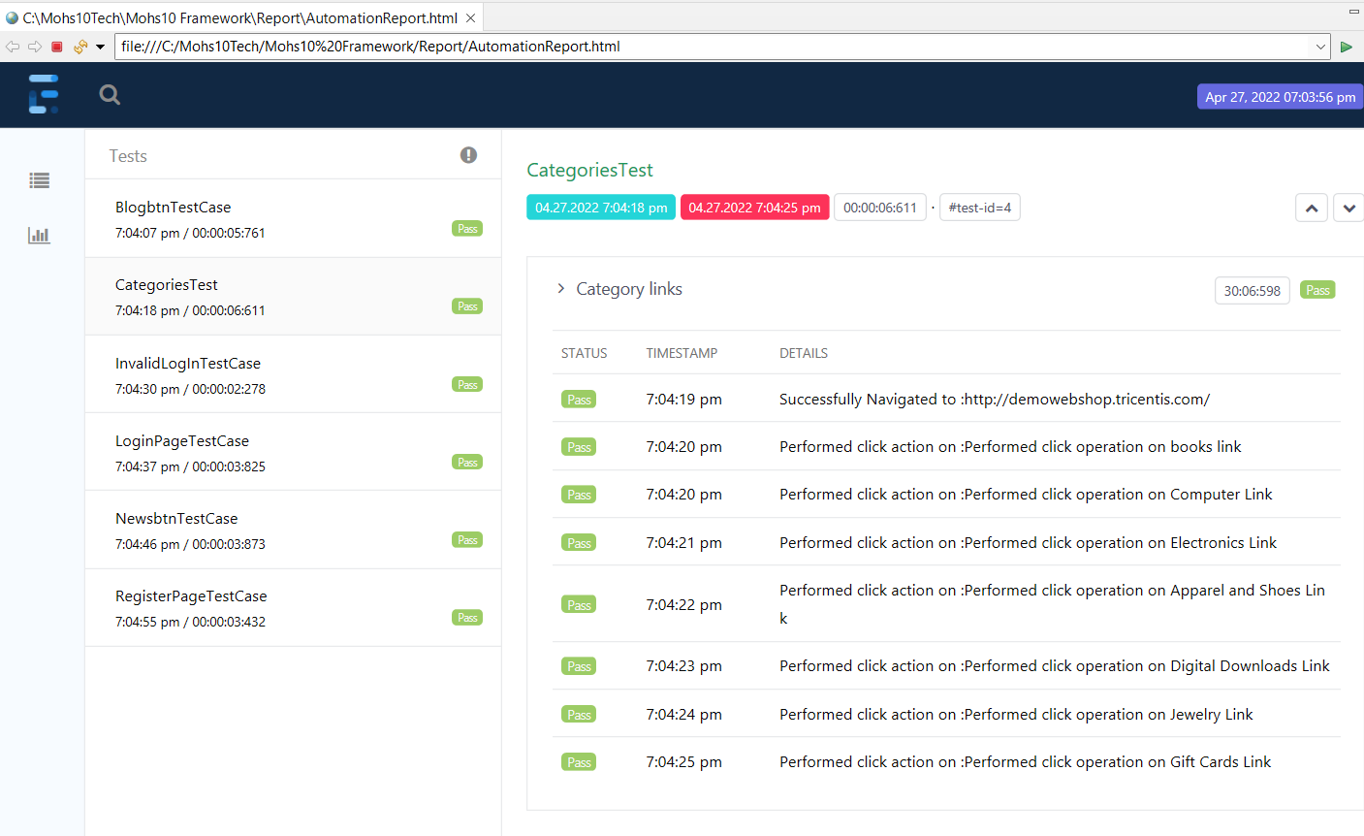
Reports
Extent Reports is being used for reporting purpose.
HTML Reports

Slide 17
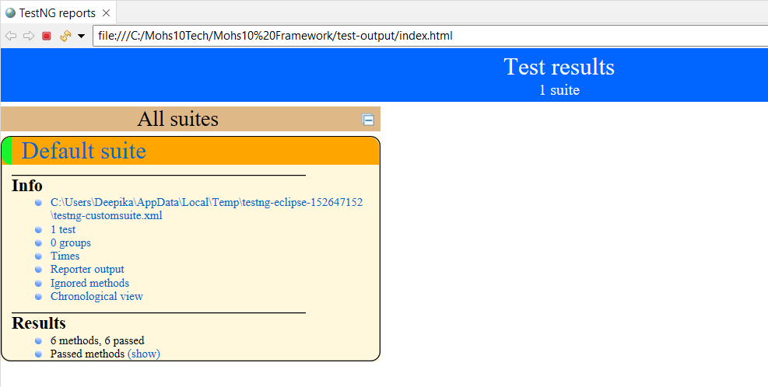
Reports
TestNG Reports

Slide 18
Steps to Create Framework from Scratch
You can follow below Steps:
Create Maven Project
Update pom.xml
Create Basic Test Class and Page Objects
Create Reusable Methods and Functions
Create Test Cases
Run test cases on desired browser
Adding new test cases.

Slide 19
Any Questions Please?

Slide 20
Thanks You…!
Presented by
Deepika R.

